Slide 1




METRO
AR COMPANION
A interactive web-based AR map for metro commuters

Slide 2
Table of contents
Introduction
Problem Statement
01
02
How it works
Final Build
03
04
A foray into Augmented Reality
What the project intends to accomplish
A deep dive into the application
The application in action

Slide 3

01
Introduction
A foray into Augmented Reality

Slide 4
Introduction
The current limitations on everyday travel has inspired this AR application that allows users to access a high quality interactive map of the CMRL using their metro card.

Slide 5
Augmented worlds
Augmented reality
Augmented reality is an interactive experience that enhances the real world with computer-generated perceptual information.
Zapworks
ZapWorks enables designers and developers to create fully-customisable AR, VR and MR experiences across print, product, packaging, retail, events and much more.

Slide 6
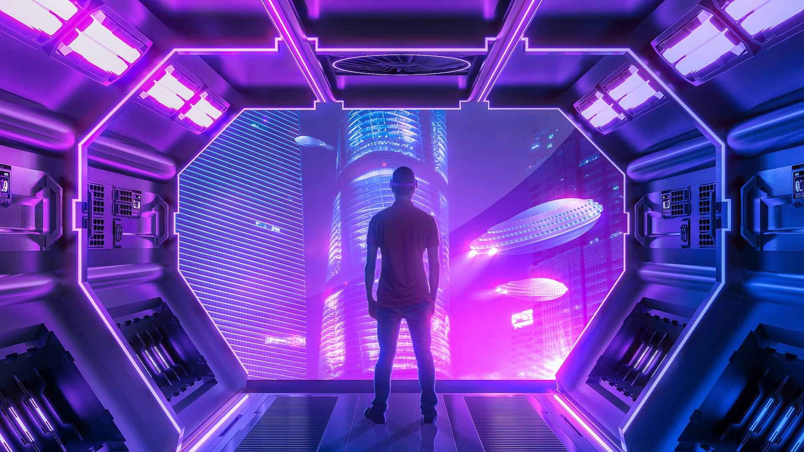
AR is 3 times more memorable compared to traditional non-AR media.
-Mindshare

Slide 7
02
Problem Statement
What the project intends to accomplish

Slide 8
Problem Statement
Metro AR Companion is a web based AR application that intends to eliminate uncertainty and help Metro commuters to better plan their trips. Users can access the CMRL route map from anywhere and tap on any station on the map to get detailed information about it.

Slide 9
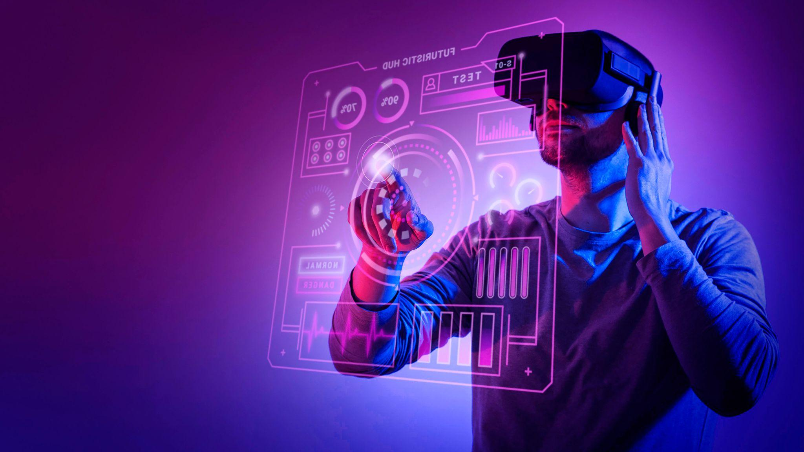
What is the Metro AR Companion?
Metro AR Companion enables commuters to easily access a high quality interactive map of CMRL through Augmented Reality.

Slide 10
03
How It Works
A deep dive into the application

Slide 11
Characteristics of the Application
Web-Based AR
Interactive
Zapworks
Image-Based
This is a web based AR app easily accessible across the globe.
The app offers easy interactivity eliminating a learning curve.
It makes use of the powerful Zapworks platform for its build.
The application makes use of Image tracking to overlay renders

Slide 12
3 Simple Steps
1
2
3
Scan QR
Point at Card
Interact
Scan the QR code to visit the Metro AR Companion web application.
Point your camera at the Metro Card to get a high quality AR map render.
You can now freely view the metro map or choose the station you’d like to know about.

Slide 13
04
Final Build
The application in action

Slide 14
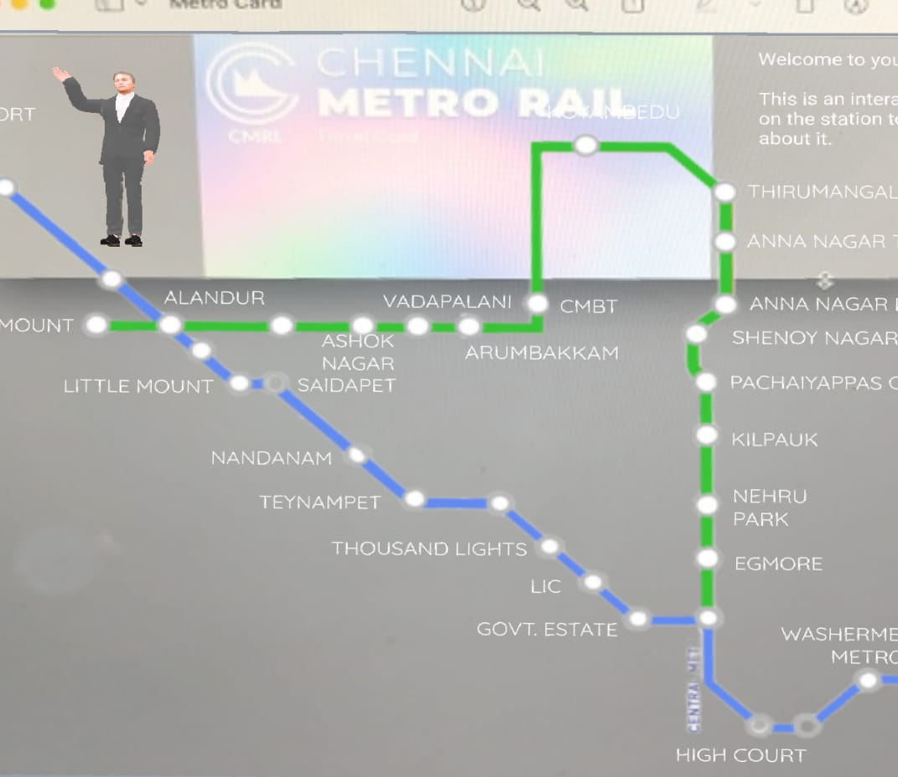
Metro Card
Metro Map
Interactive Stations

Slide 15
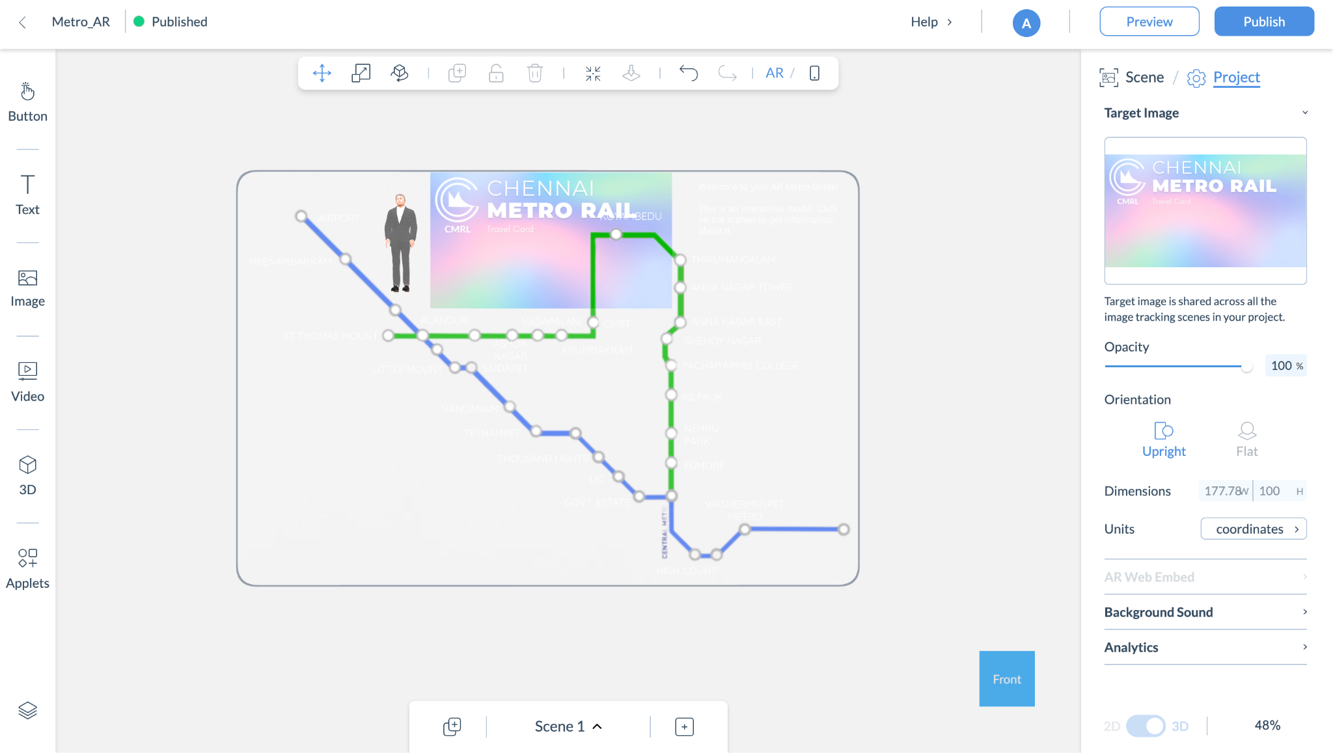
Thank You
A Project By -
Abhinav Patil [RA2011003010940]
Arpita Singh [RA2011003010937]

